Slide 1

England Premier League 13-14

Slide 2
Background
The Premier League is an English professional league for men's association football clubs. At the top of the English football league system, it is the country's primary football competition. Contested by 20 clubs, it operates on a system of promotion and relegation with the English Football League
The Premier League is the most-watched football league in the world, broadcast in 212 territories to 643 million homes and a potential TV audience of 4.7 billion people.
While 47 clubs have competed since the inception of the Premier League in 1992, only six have won the title: Manchester United (13), Chelsea (4), Arsenal (3), Manchester City (2), Blackburn Rovers and Leicester City

Slide 3
Things we want to get from data
General trends of winning/loss ratio and home and guest winning ratio and total goals and total goal lost as the teams standings
Analyzing why certain teams can not win championship even though they have shinning data.
Analyzing why certain teams got a good standing.
Analyzing why certain team didn’t get the standing that fans are expected to see .
Why certain team fall into the relegation zone?
The above analysis are focus on three areas including number of win/draw/loss, goodsecondhalf, totalgoal or totalgoalloss.

Slide 4
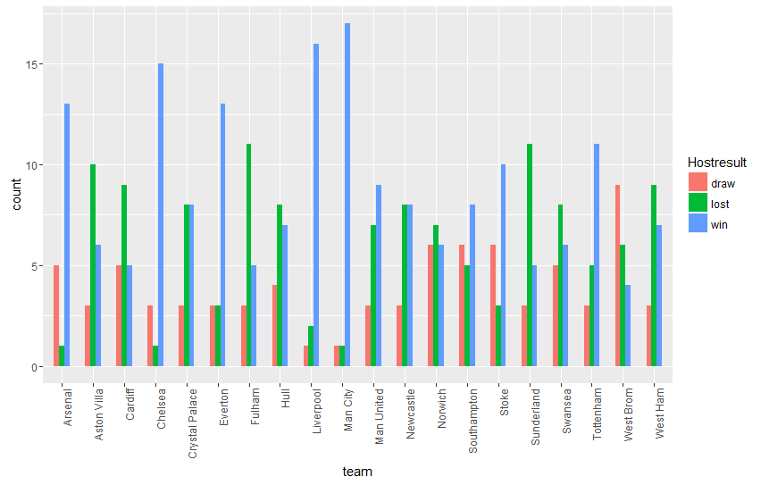
Game Results When Each Team Play at Home

Slide 5
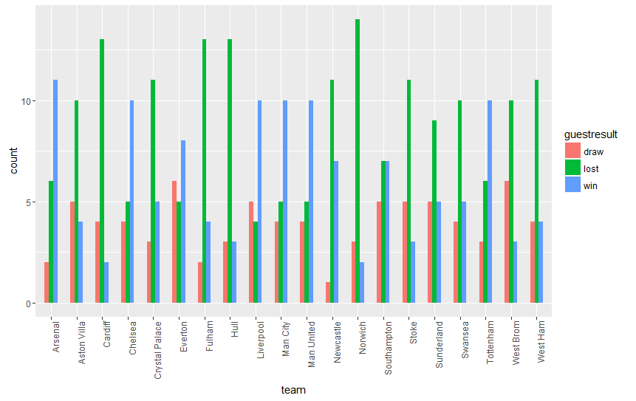
Game Results When Each Team Play as Guests

Slide 6
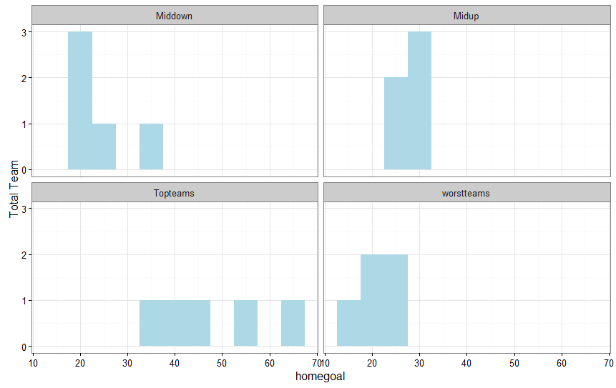
Total Goals in Terms of Different Tier

Slide 7
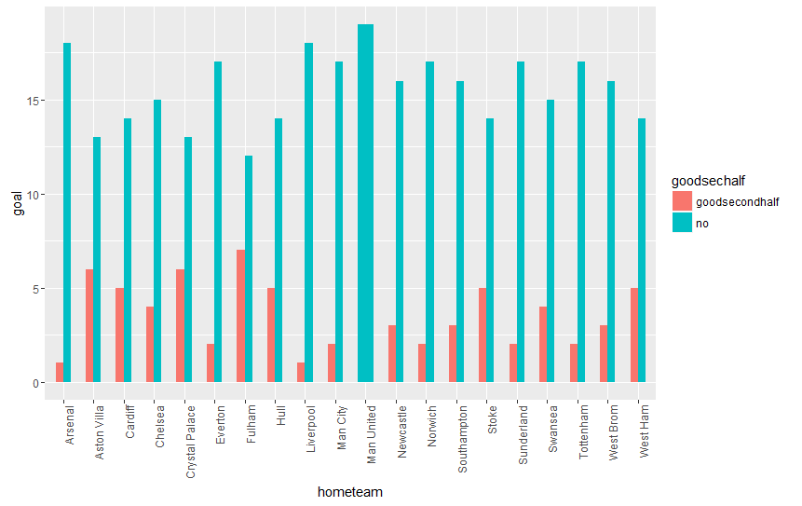
Good Secondhalf Home Team

Slide 8
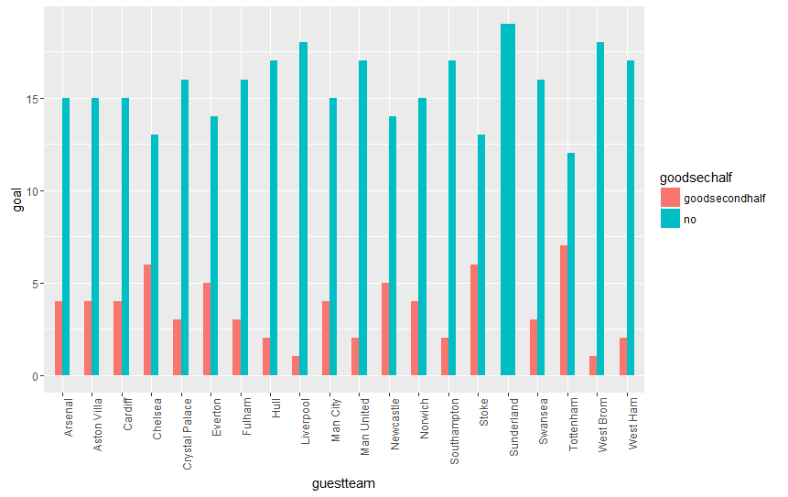
Good Secondhalf Guest Team

Slide 9
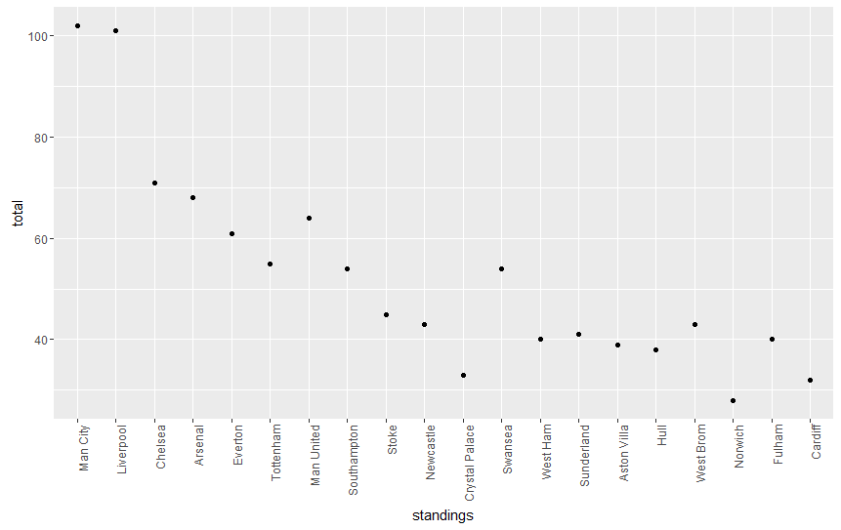
Total Goal Scored

Slide 10
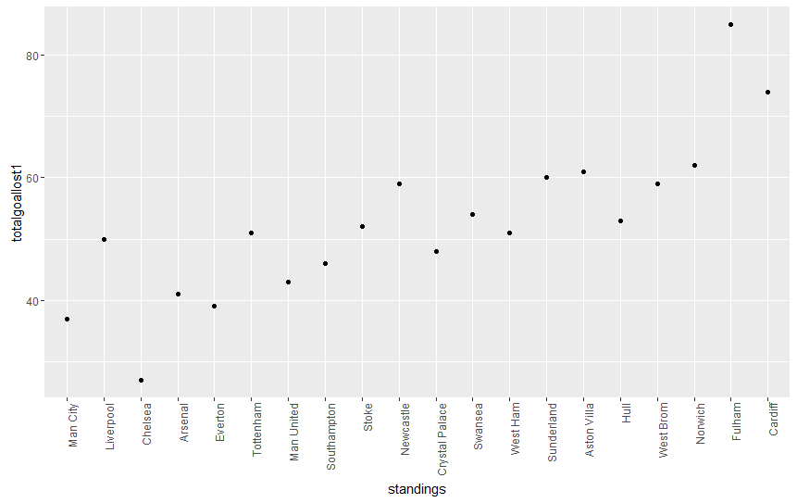
Total Goal Loss

Slide 11
Summary
General trend: The team with more wins, less loss, more goal score and less goal lost is going to be good team. On the contrary, it is going to be bad team in terms of their standings.
Each team has its own situation that may affect its standings.
The important thing is to dive into the data and find out where went wrong.
To work on the disadvantage and change the defects to get good standing next season.

